Slide 1
Introductions

Slide 2
Go around the room and introduce yourself:
2 minutes:
  Name
  Level of training/current job
  Where are you from (originally)?
  Why are you taking this course?
  What do you hope to get out of it?

Slide 3
Tell us about your best case…
Notes:
Go around the room and encourage 2-3 “good cases” to discuss and refer to during the morning

Slide 4
Case Presentation
36 yo male at home cleaning his gun. Upon attempting to clear the weapon, accidentally shoots himself through his nondominant left hand and left distal thigh.
Brisk bleeding and wife attempts to place a makeshift tourniquet around his leg. Then she calls 911, with first response (volunteer EMT) arriving 11 minutes later…
EMTs: What do you do? What do you want to know?
Notes:
Encourage discussion

Slide 5
Case Presentation (cont.)
Vitals: Awake and talking, HR 107, RR: 22, O2 Sats: 96%
Placed on a gurney and loaded into ambulance
Begin drive to meet ALS transport…
EXERCISE (~5 minutes):
  Pull out a piece of paper and something to write with
  Write down everything you need to do (each task) for this patient
Notes:
Give about 5 minutes to PUT PEN TO PAPER.
Ask for a few of the items from a couple of people.
Answers don’t matter so much as them beginning to realize the steps that must occur. Tell them we will cover some of these and that they will be PRESENTED A CHECKLIST towards the end to practice with.

Slide 6
A Brief History of Blood Transfusion
Notes:
**THERE’S A LOT OF NOTES IN THIS SECTION. IF MOST STUDENTS WATCHED THE RECORDED LECTURES, FEEL FREE TO HIT THE HIGHLIGHTS ONLY**

Slide 7
Learning Objective
Describe the history of blood transfusion and discuss why blood components became the default standard for resuscitation of hemorrhage
Copyright Specialized Medical Standards 2025

Slide 8
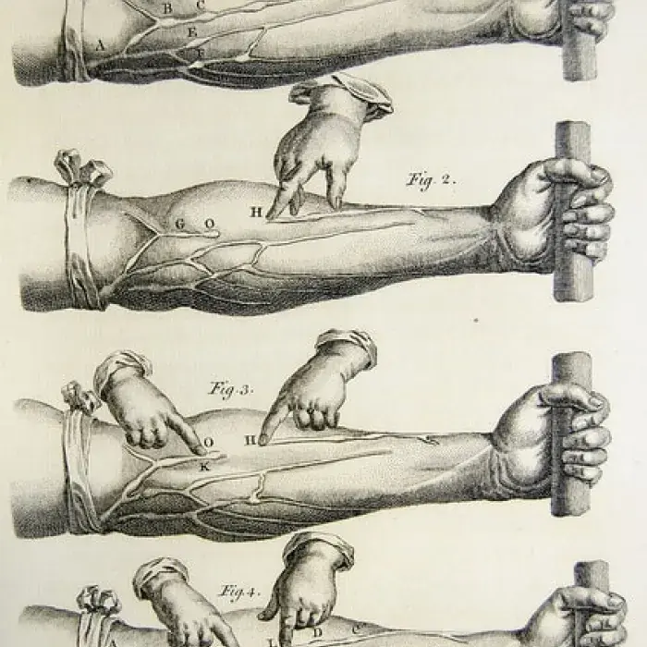
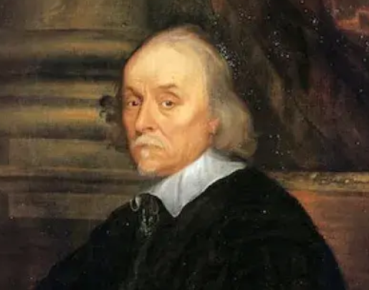
History
1628 - English physician William Harvey discovers the circulation of blood.
Illustrations of Harvey’s experiments from De Motu Cordis, 1628
Notes:
Harvey was “father of Medicine” who first dissected human bodies and figured out there was a circulation system.
Source: Highlights of Transfusion Medicine History
Illustrations of Harvey’s experiments from De Motu Cordis, 1628

Slide 9
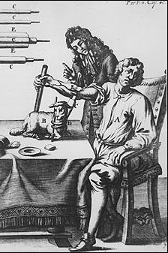
First Transfusion- 1667
Jean Baptiste Denis, Paris
Transfused patient (mental disorder) with lamb’s blood x3 sessions
  Transfusion reaction (“pain in kidneys”)
  Pt died after third transfusion
  Wife- arsenic poisoning
  Parliament banned practice
Denis credited with Stiptik
Notes:
The Affair of the Transfusions climaxed after the death of Madame de Sévigné’s ex-valet Antoine Mauroy de Saint-Amant in February 1668, who suffered from some form of dementia (perhaps caused by syphilis), following his third transfusion by Denis and Emmerez. The first two transfusions using the blood of lambs, performed just before Christmas 1667, had by Denis’ account gone well, and the patient, much to the relief of the gens de bien (the well-to-do), “received devotionally his Creator during the Jubilee”.⁶ Yet by the end of January, the madness of Mauroy had returned, and, by all accounts, things went awry. His wife, born Périne Pesson, pressured Denis incessantly to perform the transfusion, then quickly buried her husband’s body before an autopsy could be performed and immediately filed suit before the Paris courts. A dramatic cause célèbre ensued, the moral depths of which “Zola himself can hardly rival”, wrote historian Harcourt Brown.⁷ In April 1668, the Châtelet court exonerated Jean Denis, for the widow was found to have poisoned her husband with arsenic (possibly provided by La Martinière, at least according to Basril), and three unnamed doctors of the Paris Medical School were implicated in bribing Pesson to bring charges against Denis. On appeal, the Paris Parlement ruled in 1670 — on what basis we will never know — to ban doctors and surgeons from “exercising the transfusion of blood under penalty of corporeal punishment”, a sanction that lasted until after the French Revolution. Beast in the Blood: Jean Denis and the “Transfusion Affair” — The Public Domain Review

Slide 10
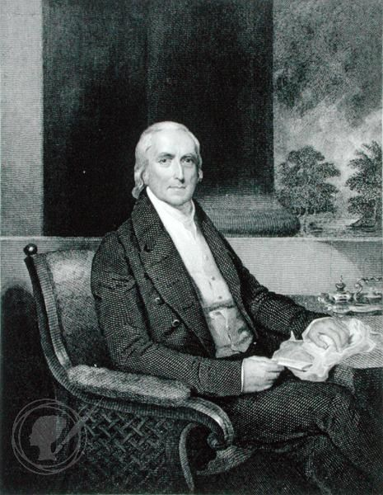
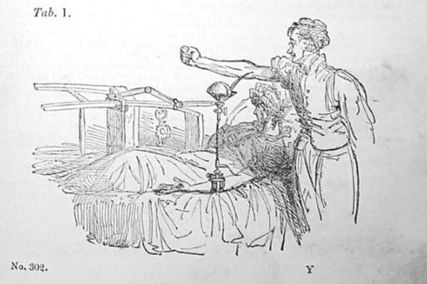
150 years later…
1795 - Philadelphia, American physician Philip Syng Physick, performs the first human blood transfusion
1818 James Blundell, a British obstetrician, performs the first successful transfusion of human blood for postpartum hemorrhage. 5/10 transfused patients show improvement
Notes:
Blundell - Using the patient's husband as a donor, he extracts approximately four ounces of blood from the husband's arm and, using a syringe, successfully transfuses the wife. Between 1825 and 1830, he performs 10 transfusions, five of which prove beneficial to his patients
The Surprising Story of the First Blood Transfusion — History News Network

Slide 11
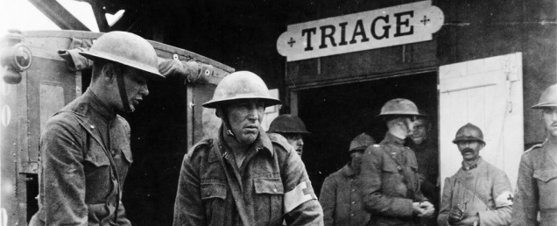
History: 1900-WW I
1900 Karl Landsteiner - human blood groups, A, B, and C. Nobel Prize for Medicine- 1930.
1914- sodium citrate (changes transfusion from direct to indirect)
1916 Francis Rous and J.R.Turner introduce a citrate-glucose solution that permits storage of blood for several days after collection.
1916 – Oswald Robertson creates blood depots
Notes:
Karl Landsteiner, an Austrian physician, discovers the first three human blood groups, A, B, and C. Blood type C was later changed to O. His colleagues Alfred Decastello and Adriano Sturli add AB, the fourth type, in 1902. Landsteiner receives the Nobel Prize for Medicine for this discovery in 1930.
1914- discovery of sodium citrate (changes transfusion from direct to indirect)
1916 Francis Rous and J.R.Turner introduce a citrate-glucose solution that permits storage of blood for several days after collection. Allowing for blood to be stored in containers for later transfusion aids the transition from the vein-to-vein method to indirect transfusion. This discovery also allows for the establishment of the first blood depot by the British during World War I. Oswald Robertson, an American Army officer, is credited with creating the blood depots. Robertson received the AABB Landsteiner Award in 1958 as developer of the first blood bank.
Image- courtesy The 100th Anniversary of the First Blood Bank

Slide 12
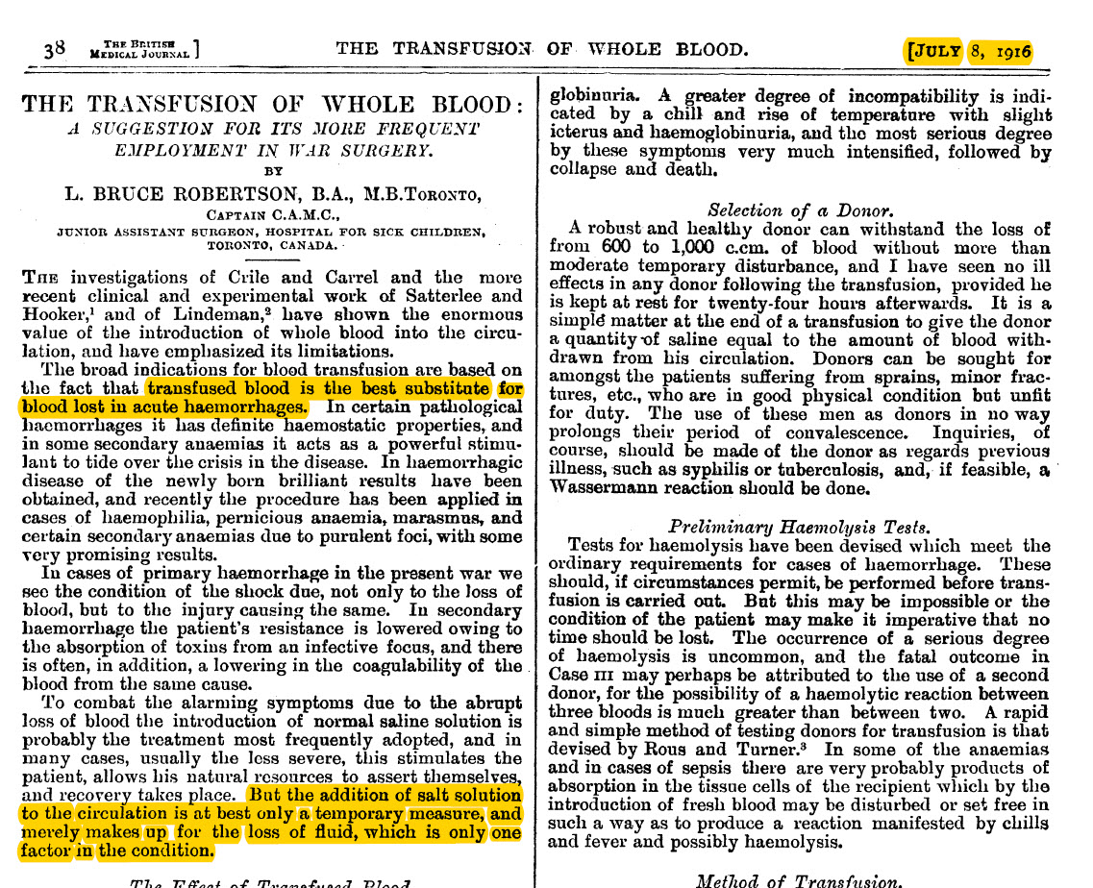
Benefit of Whole Blood

Slide 13
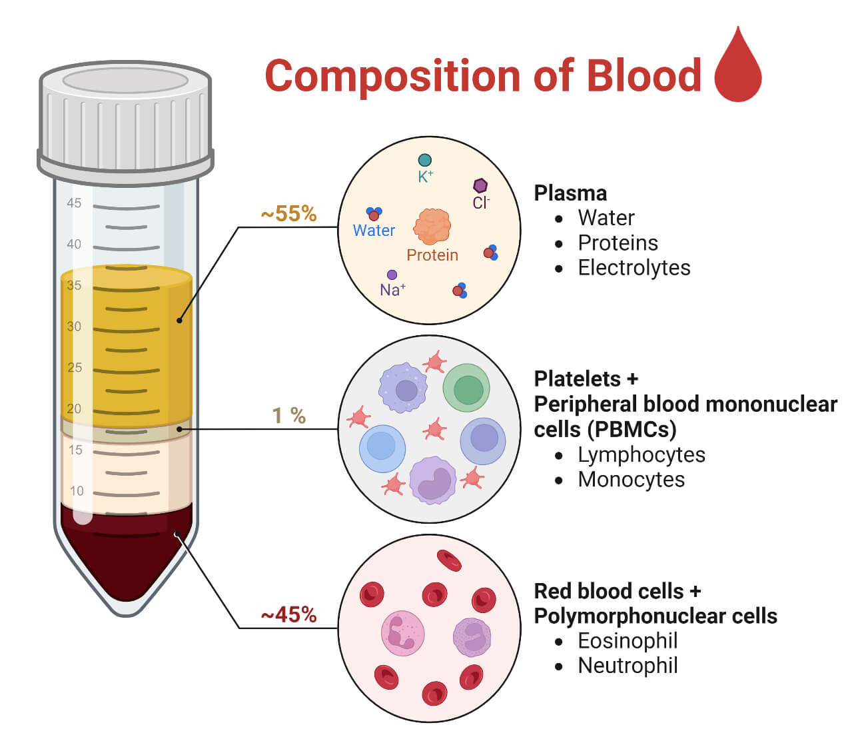
Components: WHY??
Why has component therapy been the hospital standard for over 80 years?
How did the last 20 years of war challenge that paradigm?
Notes:
Components:
-can take one unit and turn it into 3 products = more potential uses
-can be sold separately (and therefore make more total money per unit)
-can be given for specific deficiencies in different patients (but need testing before transfusion)
-when fronze (i.e. plasma) can last a lot longer than maintaining in liquid form (longer shelf life of some components when separated)
“Recent” Challenge to components: Rapid transfusion of whole blood can be done quickly with “universal donor” (type O), and SAVES LIVES in acute trauma.

Slide 14
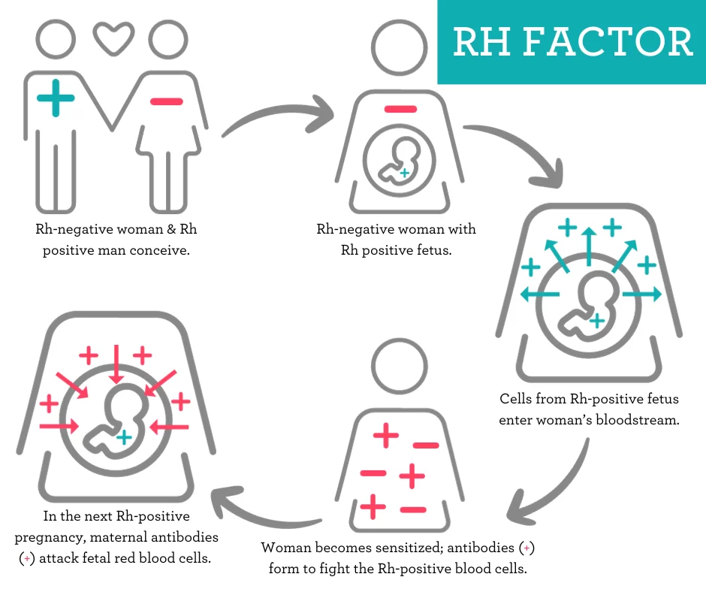
Rh Factor
1939 - Rh is discovered by Karl Landsteiner, Alex Wiener, Philip Levine, and R.E. Stetson and is soon recognized as the cause of the majority of transfusion reactions.
1940 – Edwin Cohn – cold ethanol fractionation – breaks down plasma into components/products (albumin as therapeutic)
Notes:
1939/40 The Rh blood group system is discovered by Karl Landsteiner, Alex Wiener, Philip Levine, and R.E. Stetson and is soon recognized as the cause of the majority of transfusion reactions. Identification of the Rh factor takes its place next to the discovery of ABO as one of the most important breakthroughs in the field of blood banking.
1940 The United States government establishes a nationwide program for the collection of blood. Charles R. Drew develops the “Plasma for Britain” program — a pilot project to collect blood for shipment to the British Isles. The American Red Cross participates, collecting 13 million units of blood by the end of World War II.
1941 Isodor Ravdin, a prominent surgeon from Philadelphia, effectively treats victims of the Pearl Harbor attack with Cohn's albumin for shock. Injected into the blood stream, albumin absorbs liquid from surrounding tissues, preventing blood vessels from collapsing, a finding associated with shock.
Image from: Rh Factor: What is it and Why Does it Matter? - Clearway Clinic

Slide 15
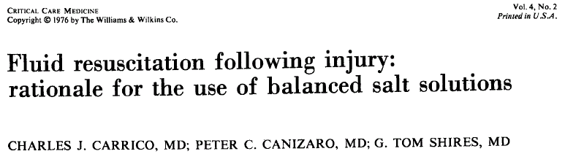
The Crystalloid Detour
What the paper reported:
What resulted/ATLS:
“Lactated Ringers is used to replace interstitial fluid and to support the intravascular volume until type specific cross matched whole blood is available.”
LR at a “very rapid rate,” 1000-2000 ml over 45 minutes until whole blood is available.
Observe if the patient is a responder or non responder
Base further whole blood transfusion on the patients response
3 to 1 crystalloid rule
Aggressive crystalloid resuscitation to restore blood pressure
Lost sight of whole blood
Lost sight of coagulopathy
Step wise component therapy “cookbook” stressed
Notes:
Shires paper from 1976 changed 3 decades of our approach to traumatic hemorrhage resuscitation

Slide 16
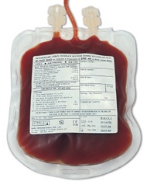
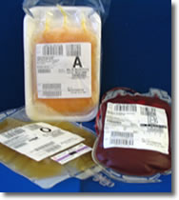
Compare/Contrast:
 | Whole Blood | Components
Hct | 40% | 29%
Platelet | 150-400K | 80K
Coagulation Factors | 100% | 65%
Fibrinogen | 1000 mg | 1000 mg
Anticoagulant | 70 | 200
Total Volume | 570 cc’s | 700 cc’s
Notes:
Special Thanks to Dr. Jay Johannigman MD,FACS
The WHOLE is better than the sum of the parts – and therefore more effective in acute resuscitation.
More concentrated in less volume

Slide 17
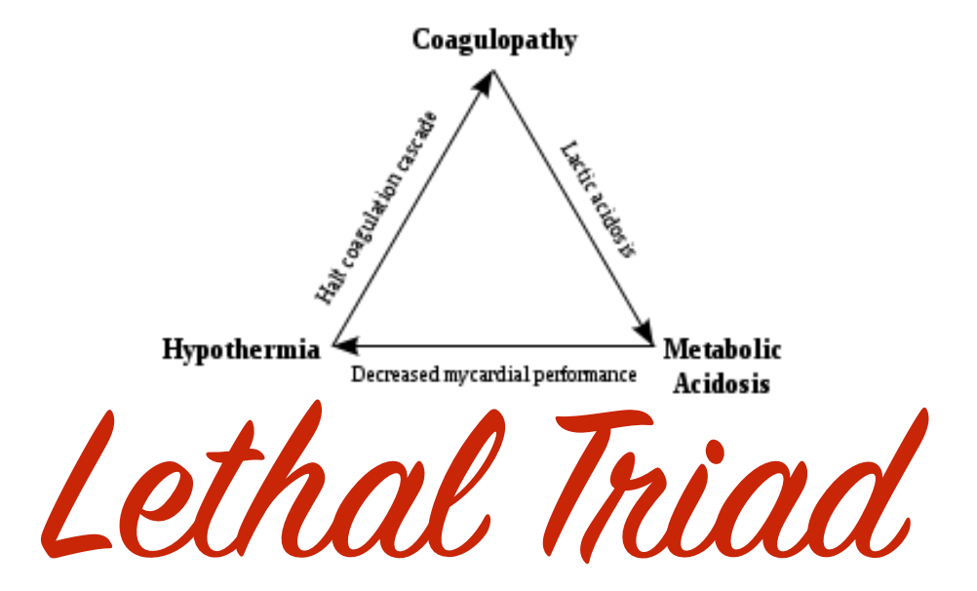
The Lethal Triad
Acidosis
Hypothermia
Death
Coagulopathy
Brohi K, et al. J Trauma, 2003.
MacLeod J, et al. J Trauma 2003
Notes:
The Lethal Triad describes those aspects seen in patients that become severely coagulopathic and portends to poor outcomes and greatly increased mortality
From: https://images.app.goo.gl/hDGbfFT6b6on2huc8

Slide 18
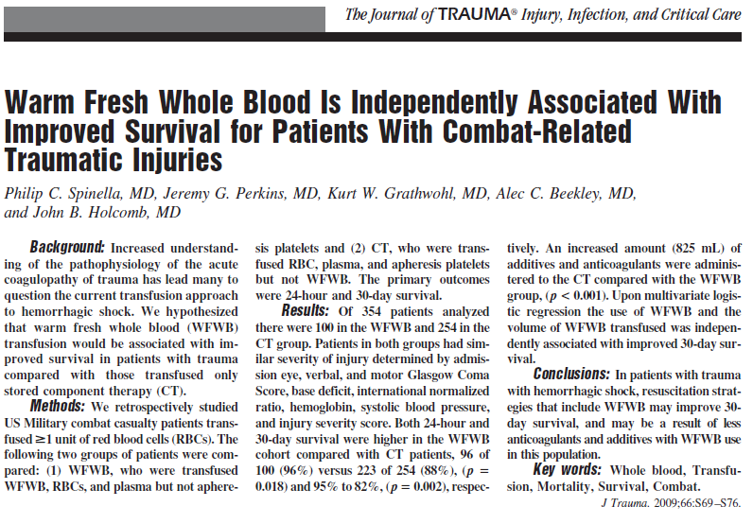
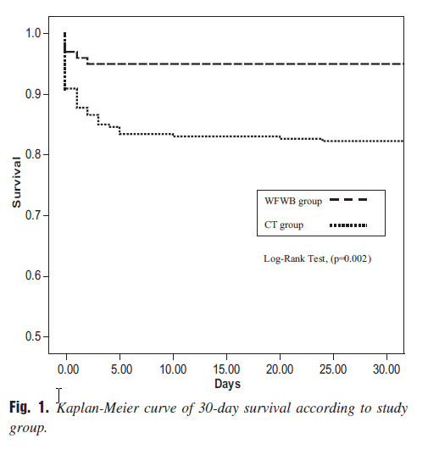
Notes:
This is one of many sentinel articles that showed whole blood directly increases survival in severely injured combat-related patients

Slide 19
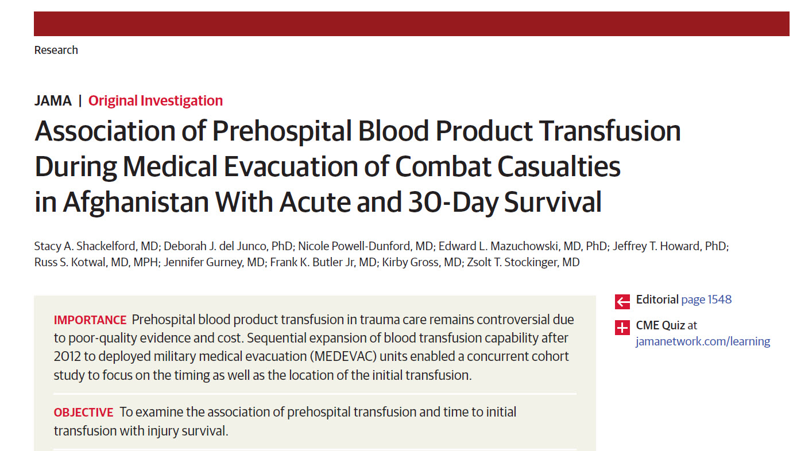
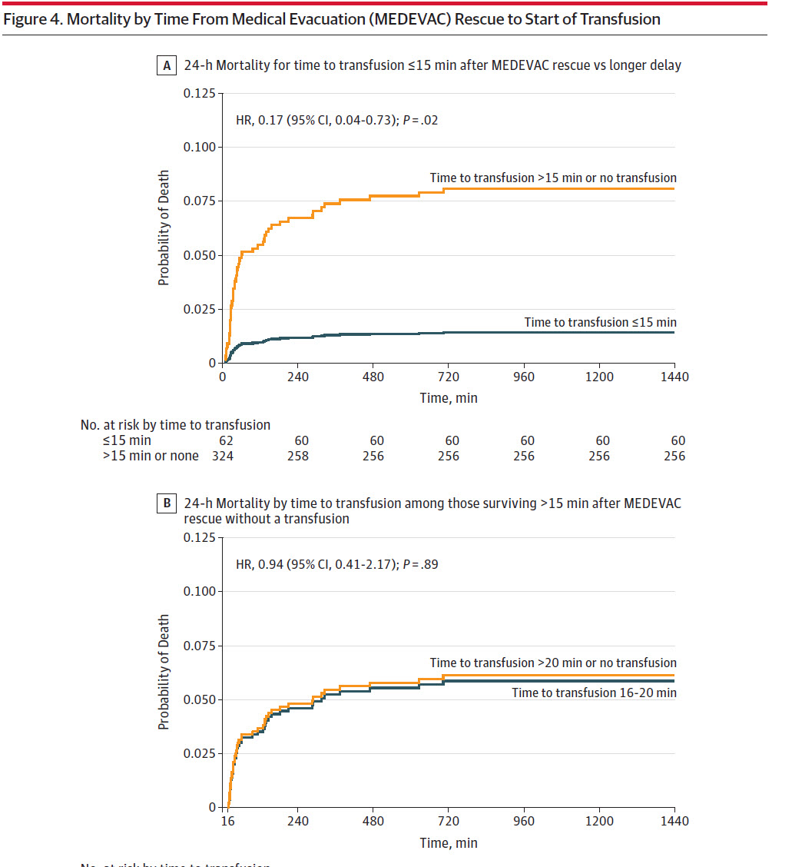
70% of all deaths in this study group occurred within 60 minutes of MEDEVAC rescue
If the casualty was alive at 24 hours– receiving blood from MEDEVAC did not improve survival
Only Transfusions initiated within 15 minutes of MEDEVAC Rescue were associated with improved 24 hour mortality
Notes:
Dr. Shackelford and her team from the Joint Trauma System clearly showed a significantly improved survivability (decreased mortality) in early prehospital blood transfusions.
This was a mix of pRBCs and whole blood
15 minutes was added to an average of 21 minutes response to show transfusion within 36 minutes of injury saves lives

Slide 20
Summary
Blood Transfusion is not new – it was proven on the battlefields of WWI, WW2, Vietnam, and now in our most recent wars
Infusion of whole blood has significantly improved mortality in hemorrhagic shock patients vs. component therapy or crystalloid
Copyright Specialized Medical Standards 2025

Slide 21
Questions/
Discussion
Copyright Specialized Medical Standards 2025

Slide 22
Recognizing and Controlling Bleeding

Slide 23
Learning Objectives
Identify life-threatening bleeding
Describe the areas of clinically significant blood loss (CARTS)
Demonstrate use of:
  Direct pressure
  Pressure points/proximal control
  Wound packing/pressure dressings
  Tourniquets
Discuss use of junctional TQ
Describe Tourniquet conversion

Slide 24
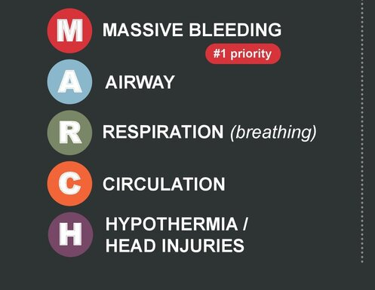
Primary Survey
What mnemonic do you use?
  MARCH
    M = Massive Bleeding
  CABCDE
    C = Catastrophic Hemorrhage
  X-ABCDE
    X = eXanguination
  Add “…and CALL for Blood!” (right away)
    Activate the resuscitation chain early
Notes:
Key to this: it doesn’t matter which mnemonic they use…time to transfusion is important!
After controlling external bleeding, the next step, if it hasn’t happened, is CALL FOR BLOOD within their system
NOTE: the Committee for Tactical Combat Casualty Care recently talked about the “C” coming after the A and R. But, in reality, with massive bleeding, there is a line that says ACTIVATE THE BLOOD SYSTEM. When they recognize and control Massive Bleeding, the next step should be: “CALL FOR BLOOOD”

Slide 25
Tourniquets – and who needs them?
Gained popular use with the military and Tactical Combat Casualty Care (and Tactical Emergency Casualty Care)
Proved to save lives in life-threatening extremity hemorrhage
Adopted by EMS, law enforcement and lay persons
Wide acceptance has led to overuse in some situations
  Up to 60-75% of tourniquets are not indicated
So, who needs them?
Notes:
The use of tourniquets to control massive external bleeding has been incredibly successful for saving lives in military settings. In fact, its success led to widespread use with law enforcement, EMS and lay persons. It’s simple, easy to teach, and effective.
The widespread adoption, however, has led to overuse in some settings. Additionally, placing a tourniquet for extended periods of time - generally defined as over 4-6 hours - may lead to life-threatening complications of reperfusion injuries leading to kidney failure, hyperkalemia and fatal arrhythmias. Tourniquet overuse could also lead to limb loss. So it is incumbent on EMS providers to understand which injuries need tourniquets.
The following exercise will help identify casualties that need tourniquets to control bleeding.

Slide 26
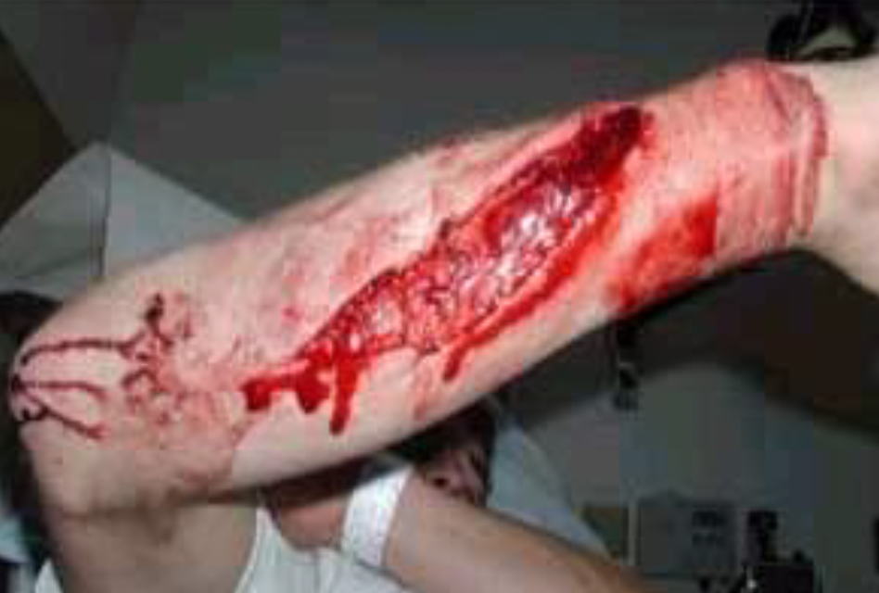
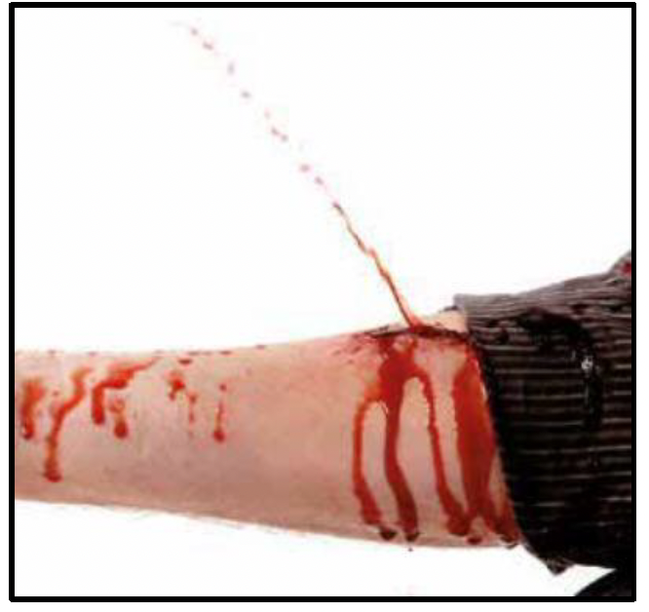
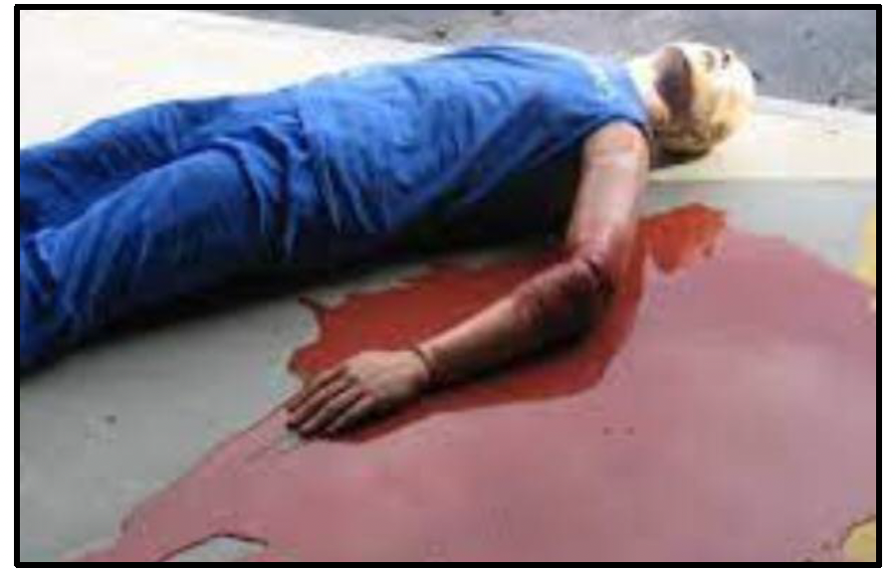

Slide 27
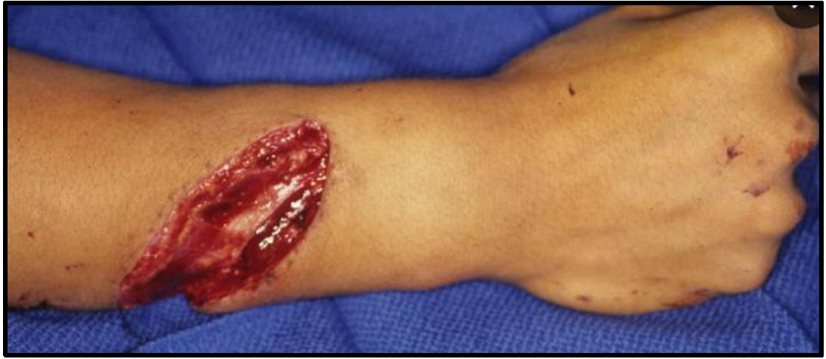
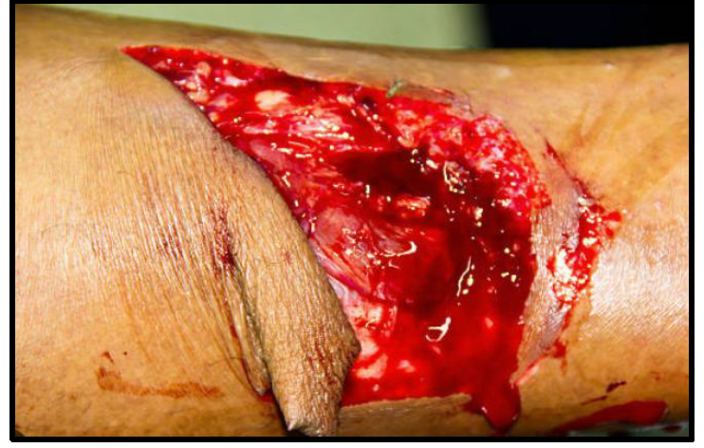

Slide 28
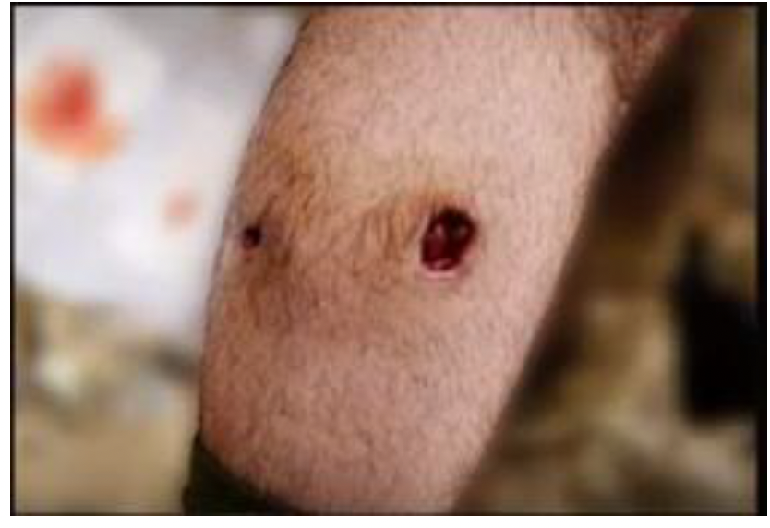
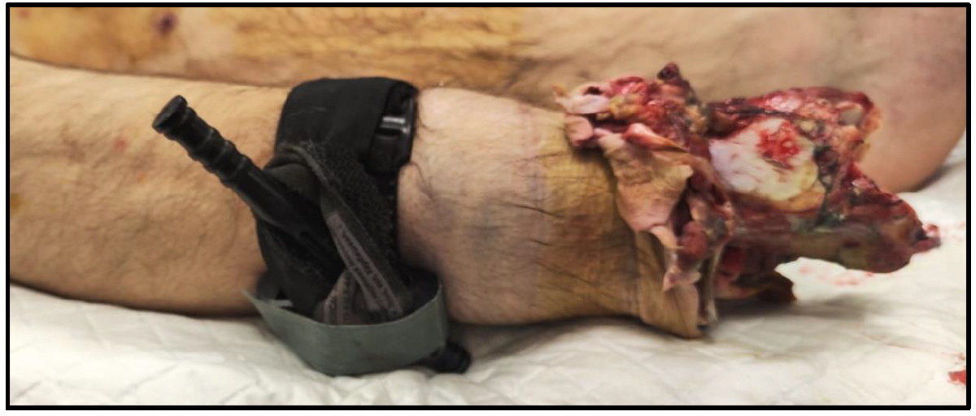

Slide 29
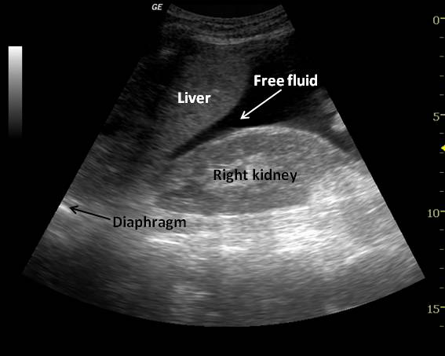
Where else can we bleed?
Use the mnemonic “CARTS”
  C
  A
  R
  T
  S
Which of these can we see?
Which of these can we image? (what imaging?)
Notes:
You might see overt bleeding: trauma to the extremities, or massive gastrointestinal bleeding – resulting in vomiting blood or passing blood from the rectum, or in the case of a pregnant patient with placental abruption. These cases will be obvious.
But what about blunt trauma without external bleeding? What about the patient who presents with hypotension and a concerning mechanism? There are a number of areas to consider which can collect blood. The CARTS mnemonic can be used as a memory aid.
CARTS stands for Chest, Abdomen, Retroperitoneum, Thigh and Street (as in - on the ground)
Retroperitoneal bleeds may occur with pelvic fractures, kidney injuries and the like. A femur fracture has the potential to bleed into the potential space in the thigh.
The chest and abdomen may be imaged with the use of point of care ultrasound using the “FAST” or “eFAST exams.” to detect free fluid, which, in the case of trauma, may represent bleeding.

Slide 30
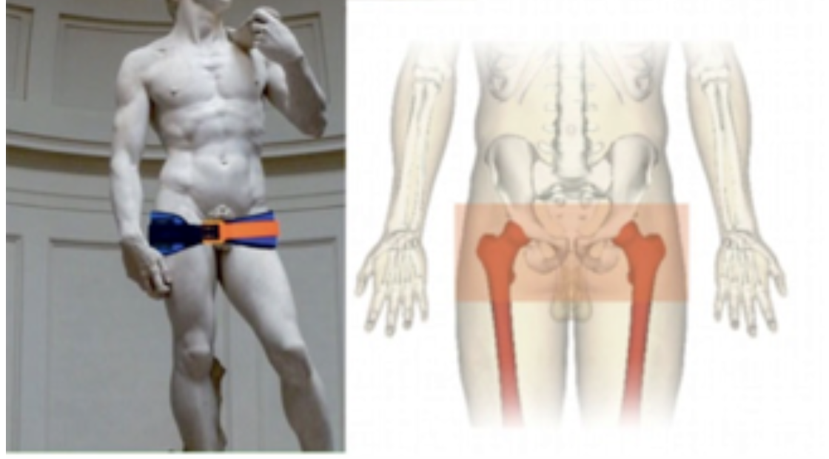
Other stabilization techniques
Wound management techniques
Pelvic binders (unstable pelvis)
Aligning a femur fracture
Internal truncal hemorrhage: get them to a SURGEON ASAP!!!
Notes:
The wound management techniques discussed earlier will be practiced in the classroom.
Other techniques may address other sources of bleeding. Bleeding from unstable pelvic fractures can be tamponaded by placing a pelvic binder to close the potential space. Similarly, straightening and aligning a displaced femur fracture or using a splint or traction device will lessen the potential bleeding within the thigh.
Lastly, for those cases which are internal – chest or abdominal – prompt evacuation to a surgeon is mandated. You won’t be able to “fix” or control these in the field.

Slide 31
Practical Exercise
How can we stop external bleeding?
  Direct pressure
  Pressure points
  Wound packing
  Tourniquets (extremity, junctional)
Notes:
Now that you’ve had a chance to consider cases of external bleeding and which might warrant a tourniquet, let’s consider other techniques available to you.
Tourniquets are fast and relatively easy to apply in situations where prompt control is needed and you may have to leave a patient temporarily or move them quickly out of danger.
In cases with less urgent bleeding, or where you have more time to address bleeding, other methods may be helpful.
At its simplest, direct pressure onto a wound may slow or stop bleeding. Wound packing with either regular gauze, or with a hemostatic dressing applies targeted pressure to the bleeding site, allowing for collateral circulation and does not cut off arterial blood flow to distal sites.
Proximal pressure points may be used in the neck, proximal arm or groin to temporarily stop major distal bleeding. Junctional tourniquets may also be used to control bleeding that is more proximal and not amenable to tourniquet use.
Some of these techniques will be practiced in the classroom setting.

Slide 32
Summary
Detecting and assessing bleeding is a core skill of every EMS provider
Tourniquets are effective for serious life-threatening hemorrhage
There are other tools that can be used to control external bleeding
Patients may have serious bleeding into different areas of the body and remember CARTS to assess
Internal bleeding needs prompt evacuation to a surgeon

Slide 33
Questions/
Discussion
Copyright Specialized Medical Standards 2025

